Slide 1
Azure Machine Learning Executive Briefing

Slide 2
Agenda
Product Momentum
Product Walkthrough
Common Usage Patterns
Interlock with AI teams
Clarifying solution areas
Developing a shared view of business
Driving awareness
Notes:
Scott

Slide 3







Azure Data & AI
Data
AI
BI
AI
Modern BI
a
Data modernization on-premises
a
a
AI apps & agents
Self-service BI
b
Data modernization to Azure
b
b
Knowledge mining
On-premises BI
c
Globally distributed data
b
c
Apps with intelligence
Machine learning
d
Cloud scale analytics
Notes:
Azure gives you the tools across Data, AI, and BI to modernize your data estate.

Slide 4
Azure AI
a
b
AI apps & agents
Knowledge mining
Machine learning
Notes:
There are three main solutions you can build with Azure AI.
Build apps that have the ability to interact with users naturally, with pre-trained AI models and bots
Build your own AI machine learning and deep learning solutions
Unlock insights lying latent in your content
<Transition> Today we’ll dive into AI Apps and Agents.

Slide 5
Azure AI
a
b
AI apps & agents
Knowledge mining
Machine learning
Notes:
TRANSITION only

Slide 6




Azure Machine Learning Momentum
Switchboard
Meeting speech
2B
Inferencing requests per month
1.5M
Experiments per month
300%
Annual growth in compute utilization
9.3k
Paying customers per month
Broadcast speech
Switchboard cellular
IBM Switchboard
1993
2000
2006
2010
2017
Notes:
Concurrency, billions of queries, etc.

Slide 7
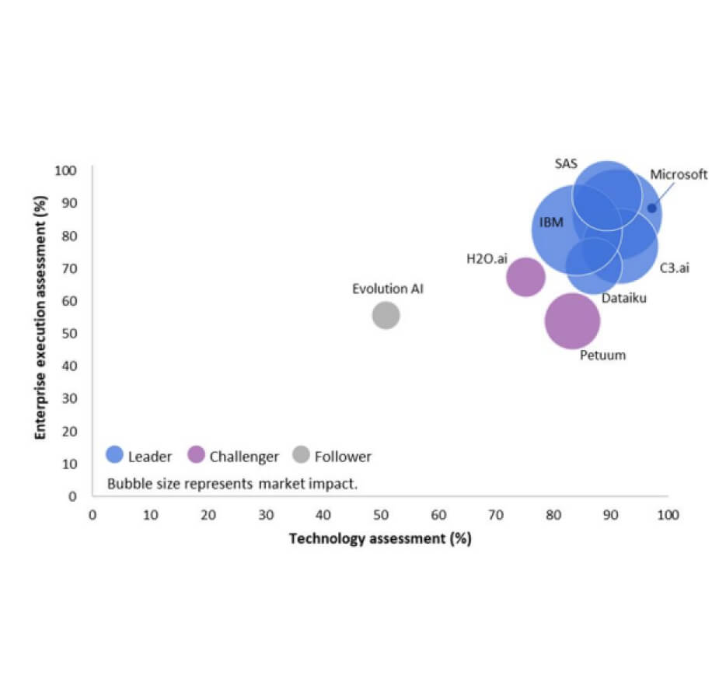
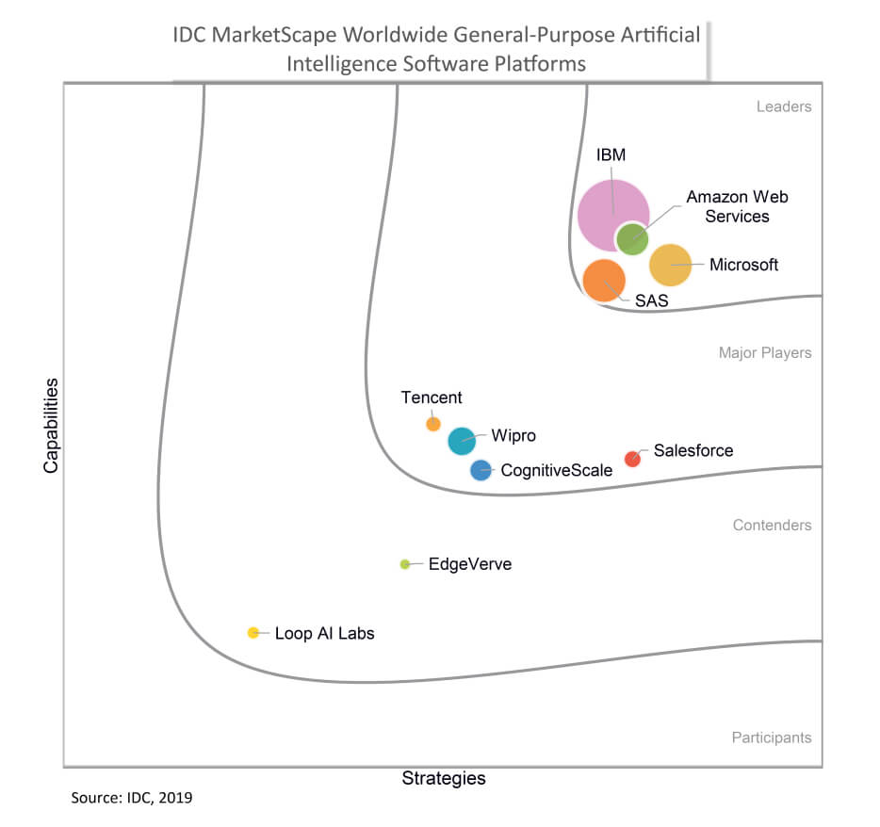
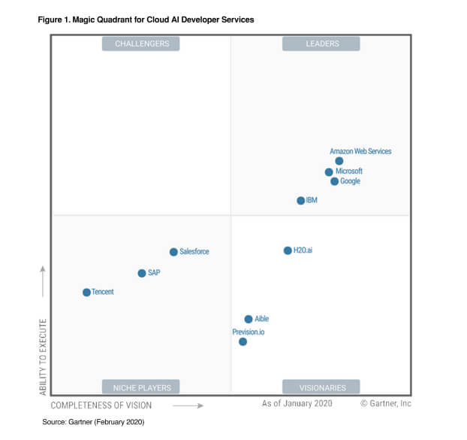
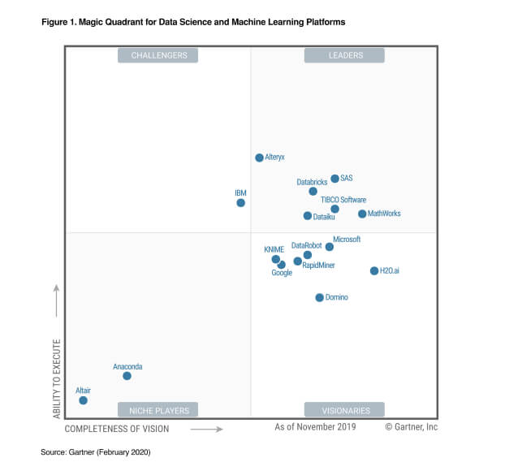
Analysts Recognition
Across top public cloud offerings
Azure
AWS
Google
LEADERS
CHALLENGERS
LEADERS
CHALLENGERS
LEADERS
Amazon Web Services
Microsoft
Amazon Web Services
Microsoft
Microsoft
Databricks
MAJOR PLAYERS
Google
ENTERPRISE EXECUTION ASSESSMENT (%)
CAPABILITIES
Microsoft
Google
CONTENDERS
Amazon Web Services
STRATEGIES
PARTICIPANTS
NICHE PLAYERS
VISIONARIES
NICHE PLAYERS
VISIONARIES
TECHNOLOGY ASSESSMENT(%)
IDC AI Platform (includes machine learning)
Gartner AI Developer Services
(includes machine learning)
Gartner Machine Learning
Omdia (Ovum) – ML Platform
Notes:
Databricks
Ability to execute (very good feedback)
OSS commitment

Slide 8
Azure Machine Learning
Customers
Azure Machine Learning
Customer promise
For all Skill levels
Industry leading MLOps
Responsible ML
Open and interoperable

Slide 9
Azure Machine Learning
Customers
Azure Machine Learning
Customer promise
For all Skill levels
Industry leading MLOps
Responsible ML
Open and interoperable

Slide 10
Azure Machine Learning
Notes:
Databricks
Ability to execute (very good feedback)
OSS commitment

Slide 11
Build models your way
Notes:
Databricks
Ability to execute (very good feedback)
OSS commitment

Slide 12
Collaborative Notebooks
Notes:
Databricks
Ability to execute (very good feedback)
OSS commitment

Slide 13
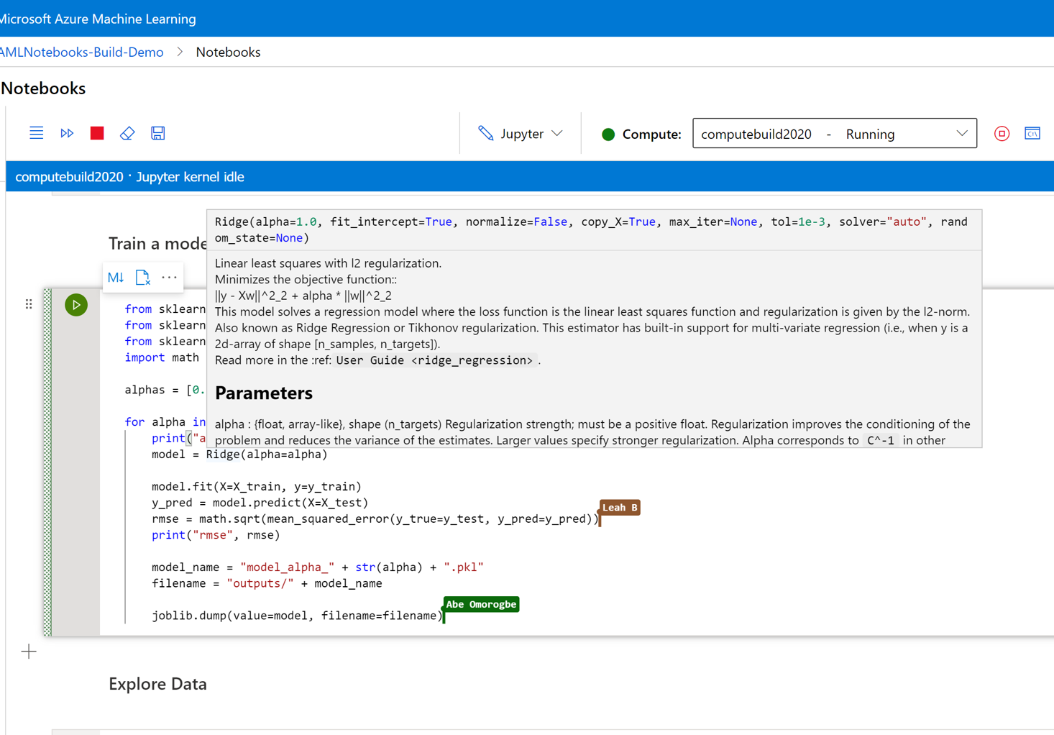
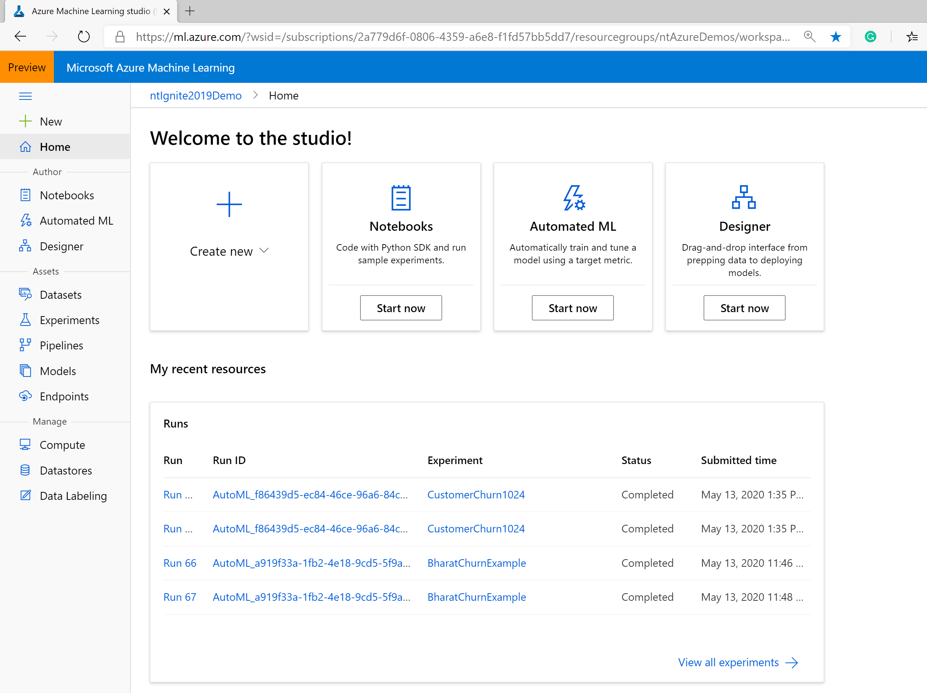
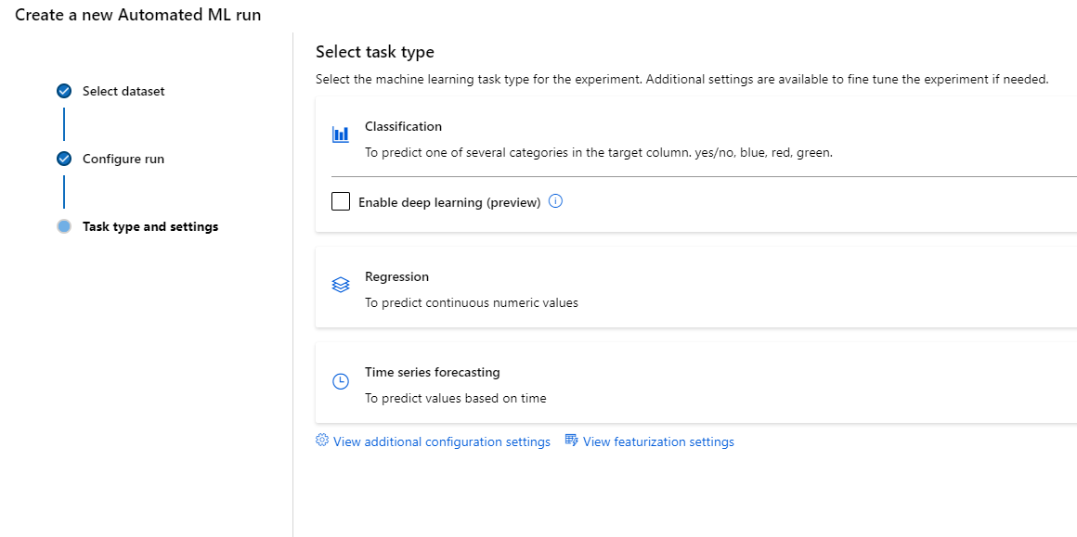
Collaborative Notebooks Build and deploy models easily using integrated notebooks and popular tools. Collaboratively debug models and share notebooks within the boundaries of workspace. Broad support for Azure VM types and persisted low-level customization makes advanced scenarios Pre-configured environment with up-to-date ML packages, GPU drivers and everything Data Scientists need to save time on setup tasks.
Notes:
Discoverability
File Explorer (not integrated with Git)
Switch between compute targets
Intellisense

Slide 14

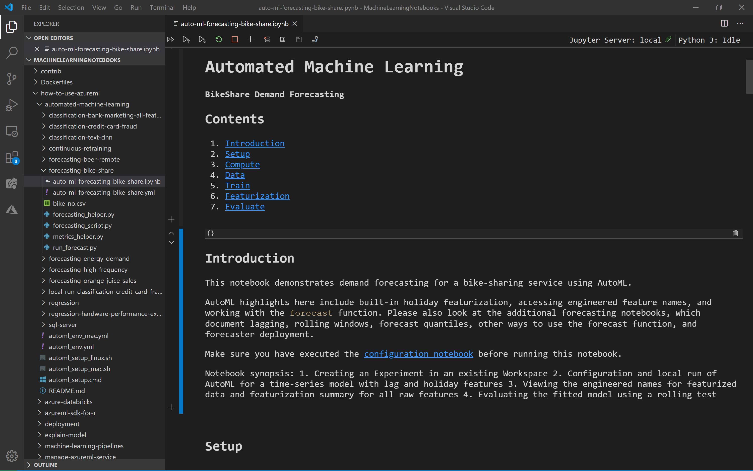
Popular IDEs Fully managed cloud-based solution for data scientists to get started with ML machine learning Deeply integrated with Azure ML workspaces and datastores first-class experience for model authoring through integrated notebooks using Azure ML Python and R SDK. Management and enterprise readiness capabilities for IT administrators.
Databricks
Amazon Web Services
Notes:
Databricks
Ability to execute (very good feedback)
OSS commitment

Slide 15
Automated Machine Learning
Notes:
Databricks
Ability to execute (very good feedback)
OSS commitment

Slide 16
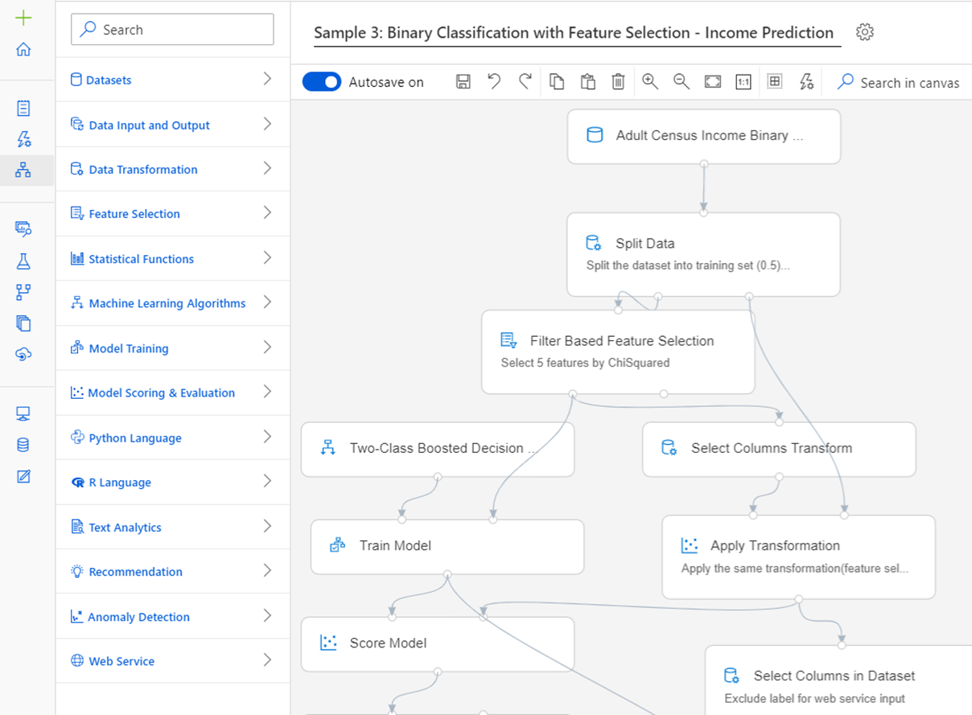
Automated Machine Learning Automatically build and deploy predictive models using the no-code UI or through a code-first notebooks experience. Increase productivity with easy data exploration and profiling and with intelligent feature engineering. Easily create accurate models customized to your data and refined by a wide array of algorithms and hyperparameters. Build responsible AI solutions with model interpretability and fine-tune your models to improve accuracy.
Notes:
Databricks
Ability to execute (very good feedback)
OSS commitment

Slide 17
Accelerate model development with automated machine learning
Input
Intelligently test multiple models in parallel
25%
Optimized model
25%
40%
Enter data
70%
25%
40%
70%
95%
95%
Define goals
25%
40%
70%
25%
40%
25%
70%
Apply constraints
40%

Slide 18
Drag & Drop Designer
Notes:
Databricks
Ability to execute (very good feedback)
OSS commitment

Slide 19
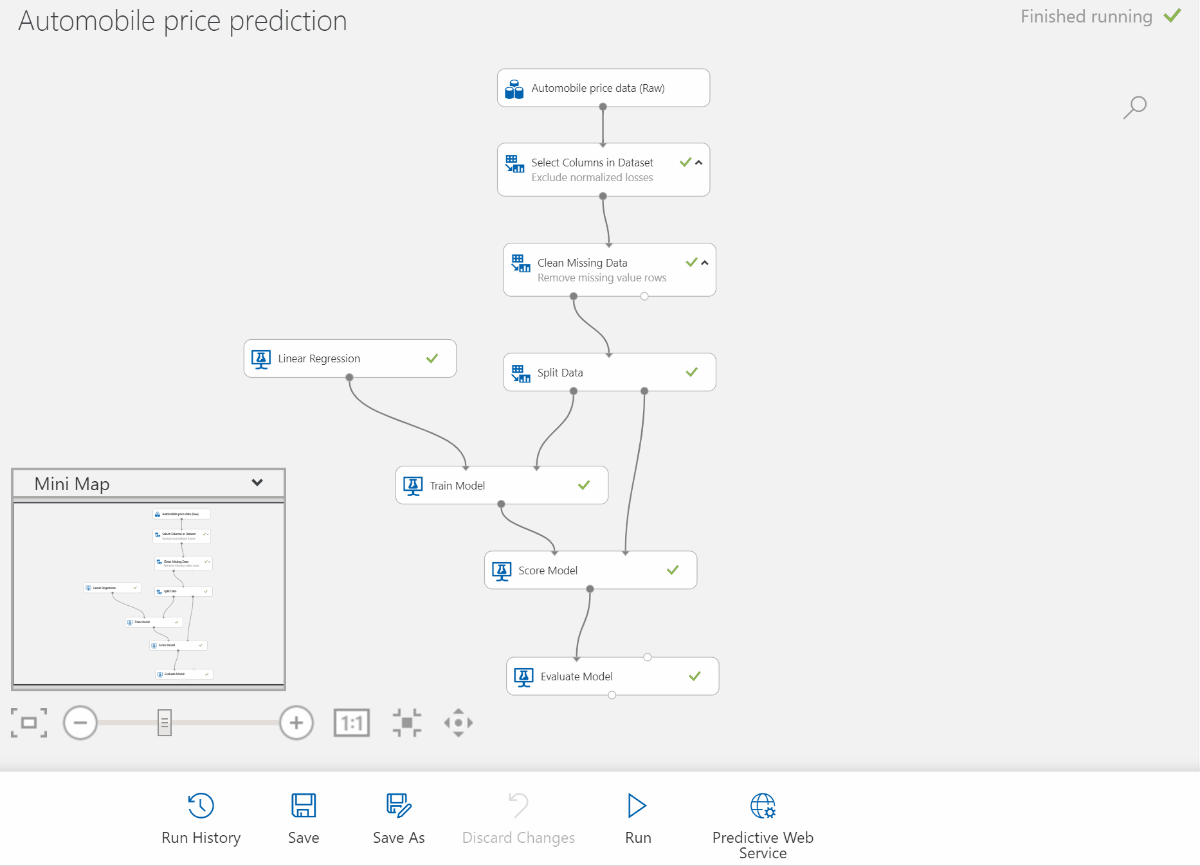
Drag & Drop Designer Drag-n-drop workflow capability Simplify the process of building, testing, and operating machine learning models Create new pipelines User built in modules, data visualization, model evaluation Automatically generate scoring files, register models and build images using AKS for scale Custom code to run Python and R
Notes:
Databricks
Ability to execute (very good feedback)
OSS commitment

Slide 20
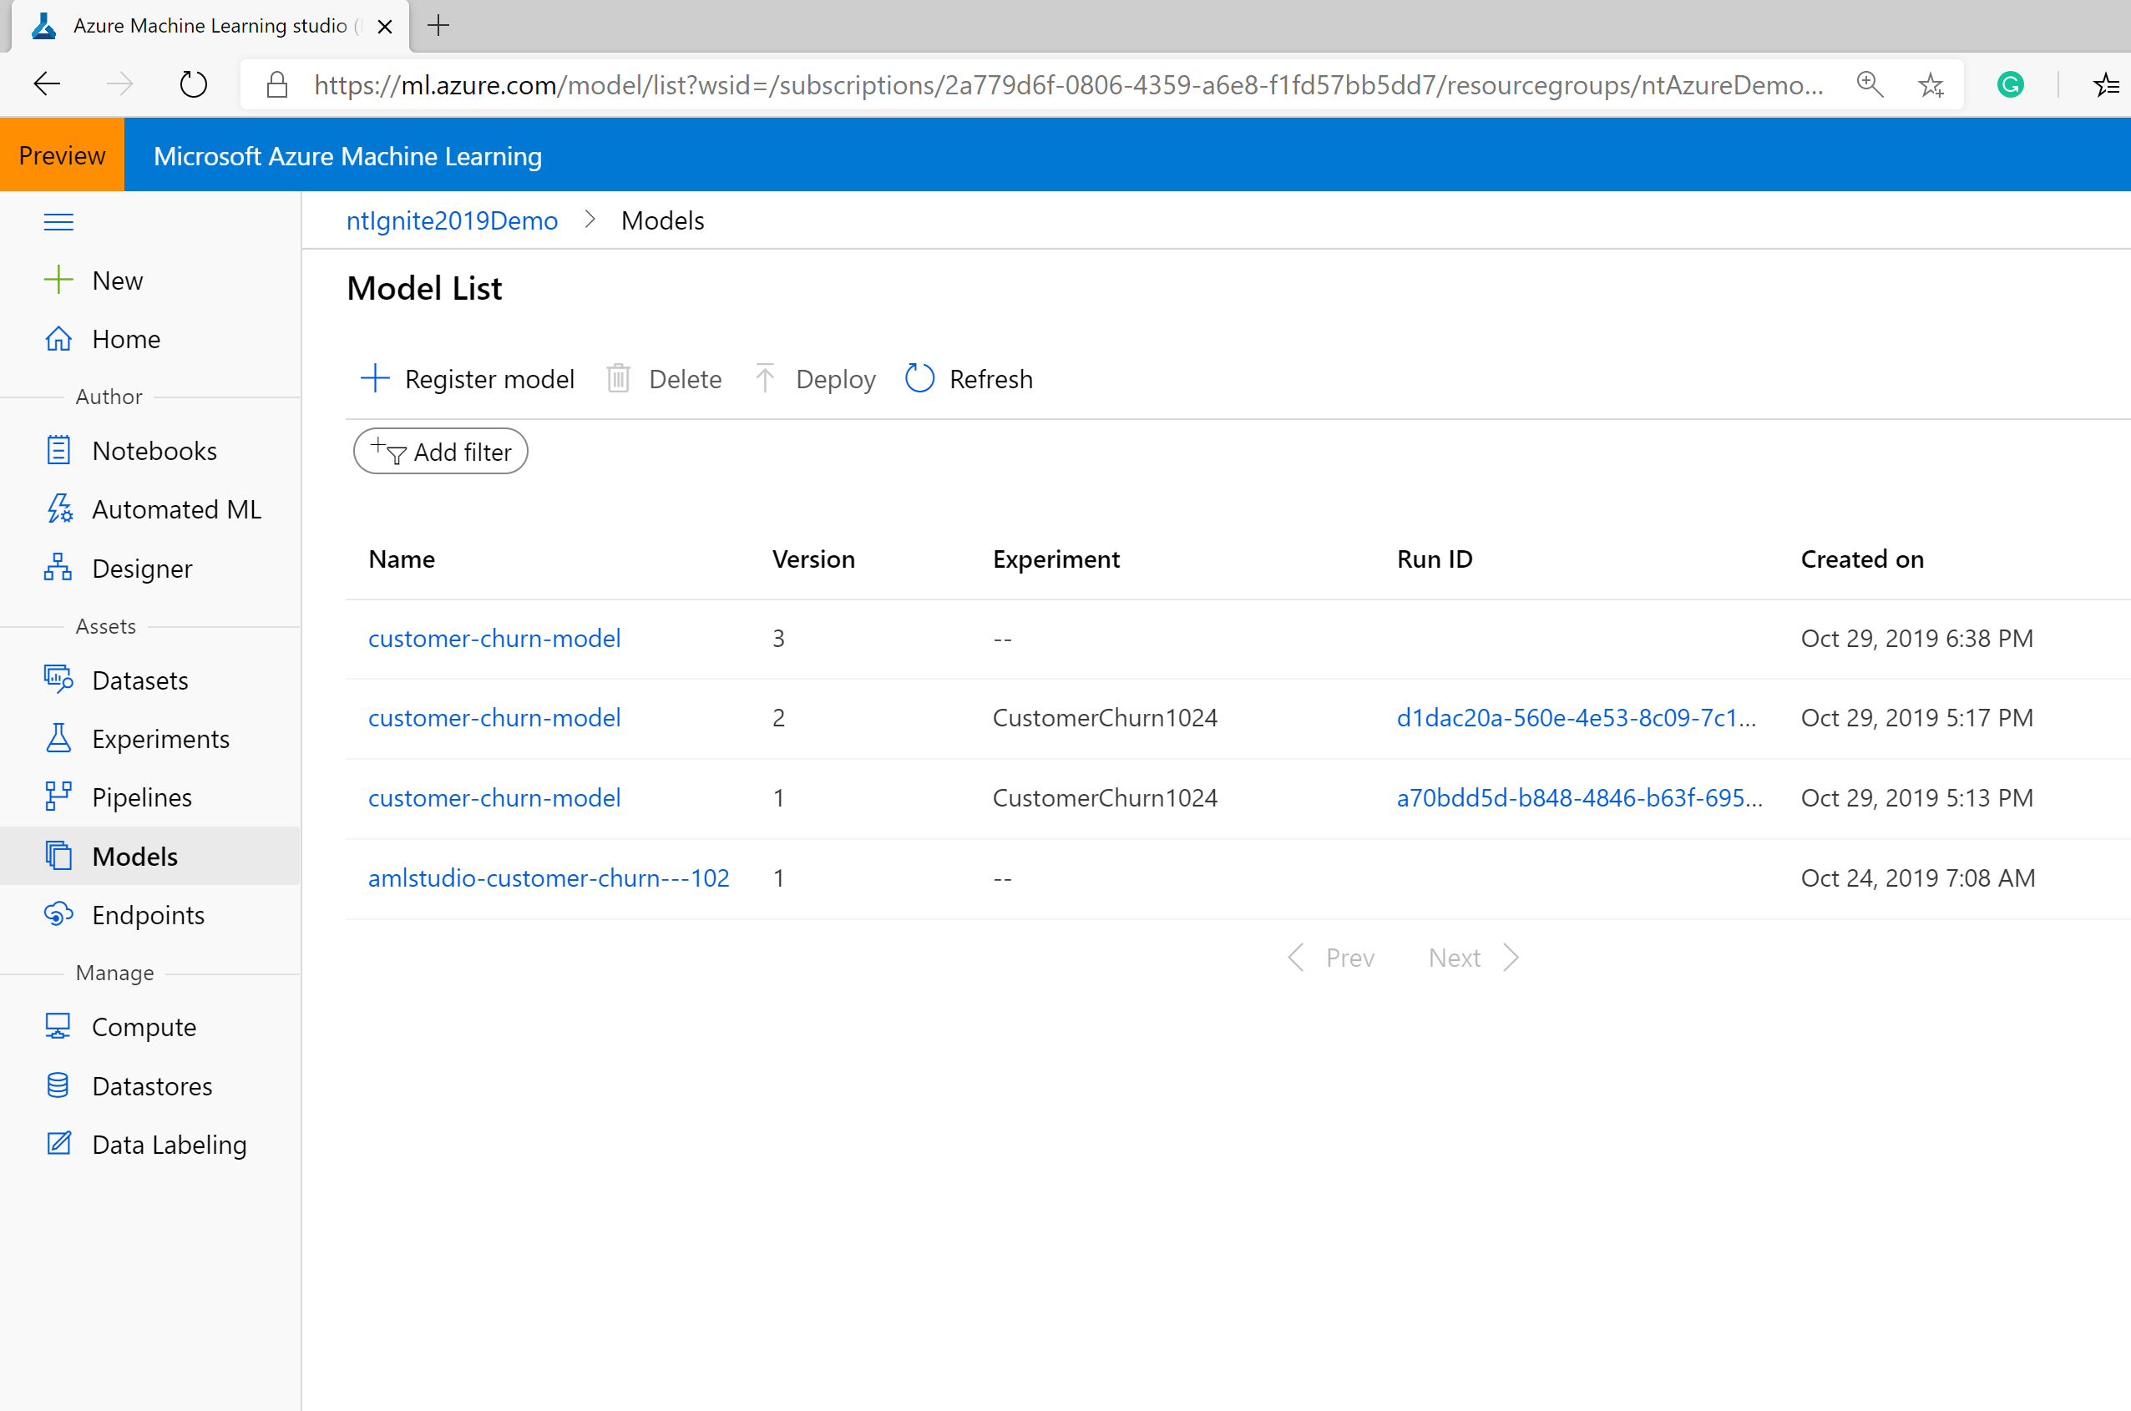
Unified model management
Databricks
Amazon Web Services
Notes:
Databricks
Ability to execute (very good feedback)
OSS commitment

Slide 21
Manage all your ML assets
Notes:
Databricks
Ability to execute (very good feedback)
OSS commitment

Slide 22
Automated ML Demo

Slide 23

Automated Machine Learning
Walgreens Boots Alliance
Augmented their analytics platform with ML to optimize marketing campaigns
Trained hundreds of models simultaneously using automated machine learning
ML for all Skill Levels
Notes:
One of the main differentiators for Azure Machine Learning is its ability to serve data scientists and developers of all skill levels. A wizard based automated machine learning experience enables users with no machine learning knowledge to build ML models. The drag-and-drop designer enables users to build machine learning models and in a no-code visual fashion. This is very popular, even with experienced data scientists. Developers and code-oriented data scientists can use the integrated notebooks with IntelliSense and co-authoring capabilities. No matter, what modality is used to build and train machine learning models, they are all stored and managed in a central registry.
Let’s look at how Walgreens Boots Alliance augmented their analytics platform using Azure Machine Learning and its automated machine learning capabilities to optimize their marketing campaigns. Boots needed a powerful process and translate the data from the millions of daily point-of-sale transactions into propensity models to optimize promotions. Their existing automated machine learning solution was resource-intensive and lacked the compute power required to efficiently produce the number of models needed. The data science teams at Boots are now using Azure Machine Learning to build over 200 models simultaneously automated machine learning propensity models on high performance GPU. Automated machine learning has improved the productivity of their data science teams by reducing the time to build and evaluate multiple models. It does most of the grunt work, allowing data science teams to focus on fine-tuning top performing models.
Link to case study: https://customers.microsoft.com/en-us/story/733091-walgreens-boots-alliance-pharmaceuticals-azure

Slide 24
Azure Machine Learning
Customers
Azure Machine Learning
Customer promise
For all Skill levels
Industry leading MLOps
Responsible ML
Open and interoperable

Slide 25


MLOps
Data Scientist
IT Professional
Model reproducibility
Model validation
Model deployment
Model retraining

Slide 26
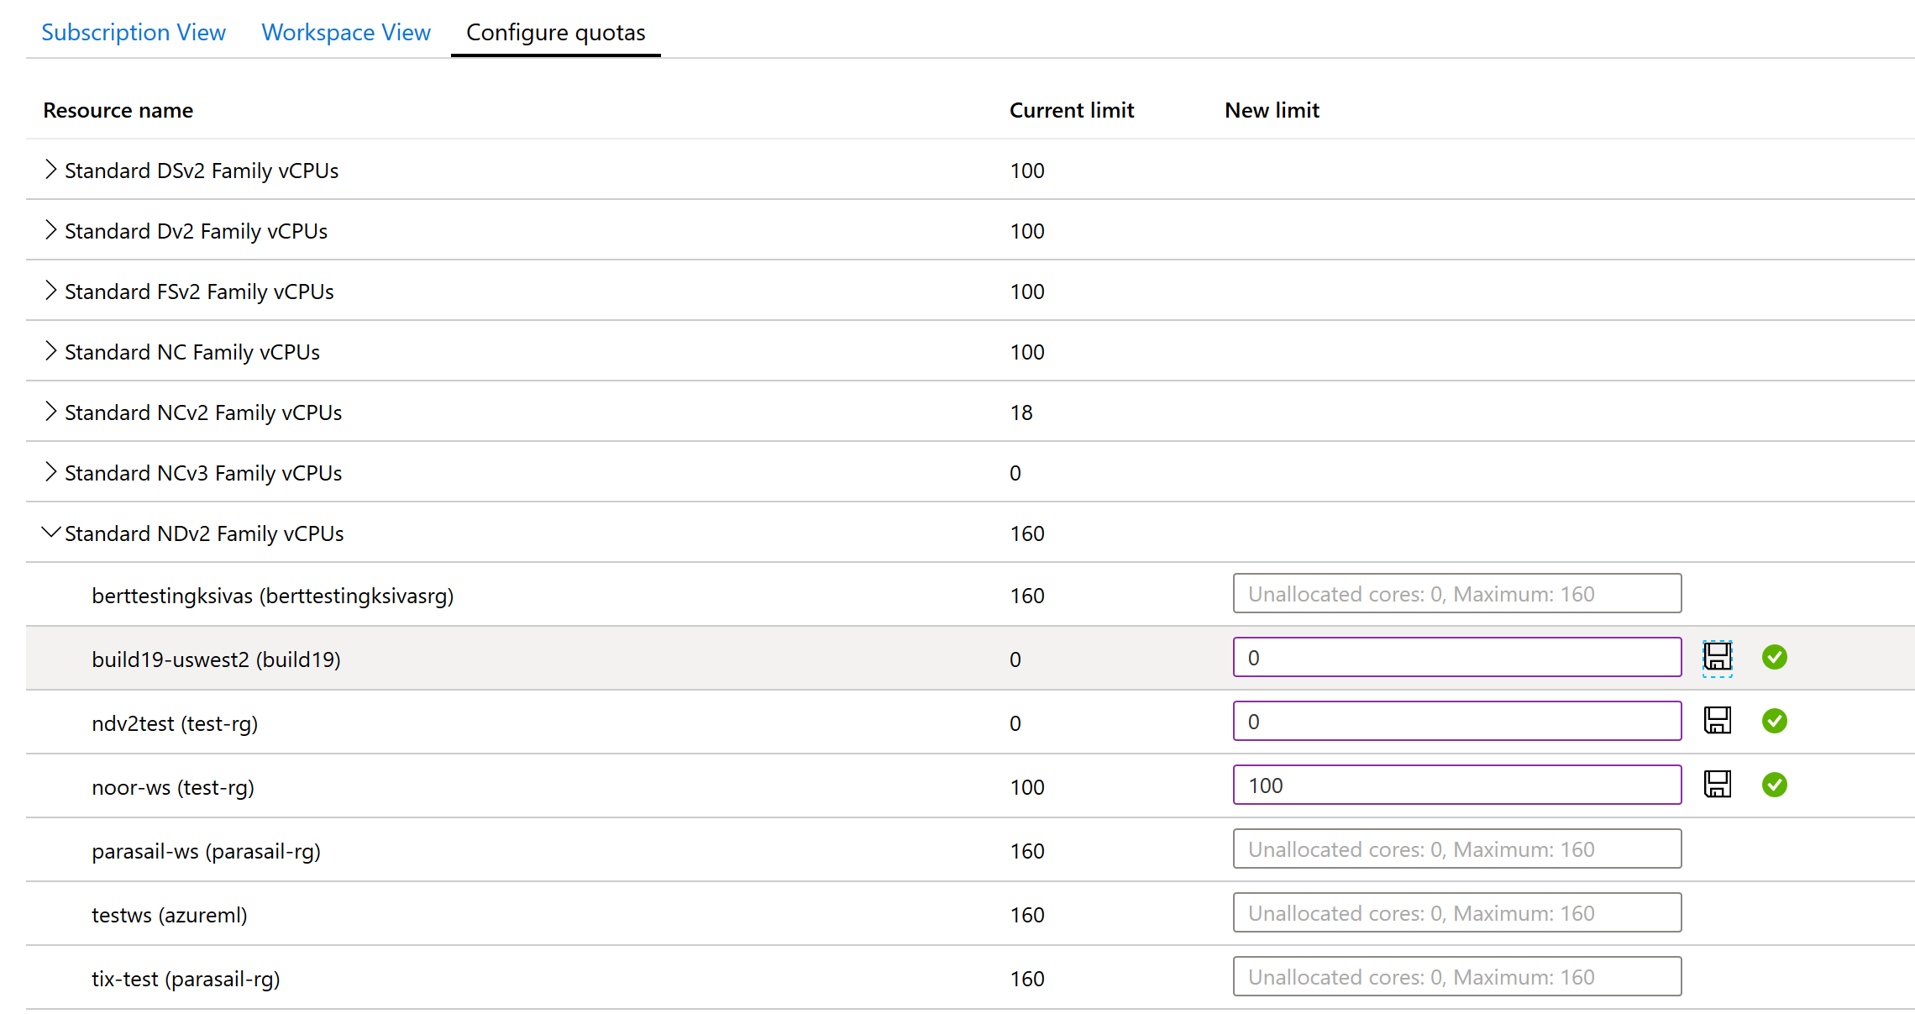
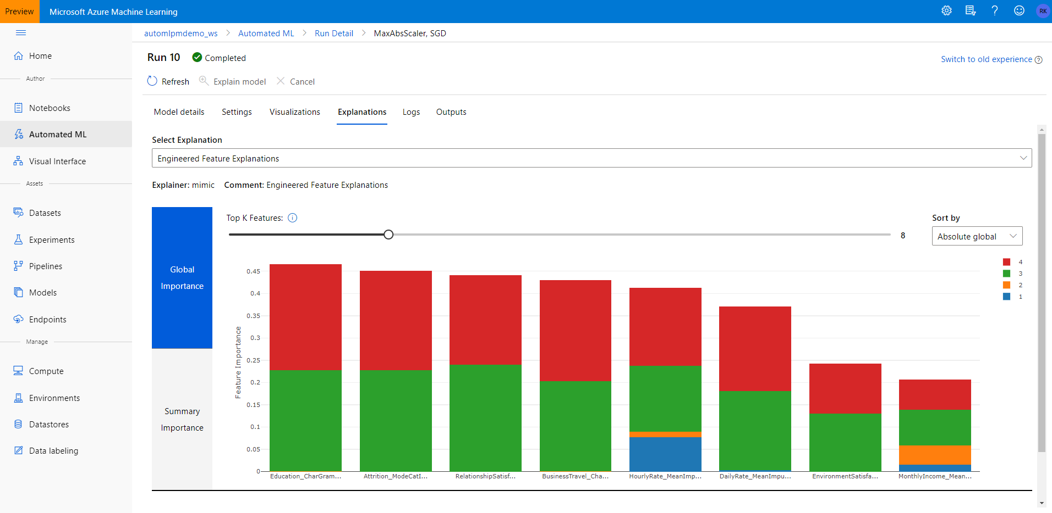
Enterprise grade ML Granular RBAC (Role Based Access Controls) give permissions to team members based on operations they can perform VNET (virtual network) acts as a security boundary, isolating ML resources from the public internet Capacity management helps with efficient resource distribution, using capacity limits
Notes:
Databricks
Ability to execute (very good feedback)
OSS commitment

Slide 27
Powerful infrastructure
Accelerate deep learning
CPUs
GPUs
FPGAs
General purpose machine learning
D, F, L, M, H Series
Deep learning
N Series
Specialized hardware accelerated deep learning
AML hardware accelerated models (Project Brainwave)
Optimized for flexibility
Optimized for performance
Notes:
We have the most comprehensive AI infrastructure
From general purpose CPUs to specialized HW (FPGAs)
FPGA -> lowest cost inferencing. Lower than Google’s TPUs
Most comprehensive set of GPU options so customers can choose the right one for their project. (best price/performance)
<Transition> Let me move to the last part of our ML portfolio.

Slide 28
Flexible deployment
From the Intelligent Cloud to the Intelligent Edge
Cloud
On-premises
Simplify deployment + accelerate inferencing with ONNX runtime
Track models in production
Capture model telemetry
Notes:
This is most important piece
ONNX helps with this, ensures simplified deployment & accelerated inferencing
Also important – Tracking of models in production and leveraging telemetry for improvement – the feedback loop
You can do this across Cloud and Edge
<Transition back to scenario>
This is the comprehensiveness we bring with our ML offering - every need catered and every requirement seamlessly met
Let’s put this back in perspective of the scenario

Slide 29
MLOps Demo

Slide 30

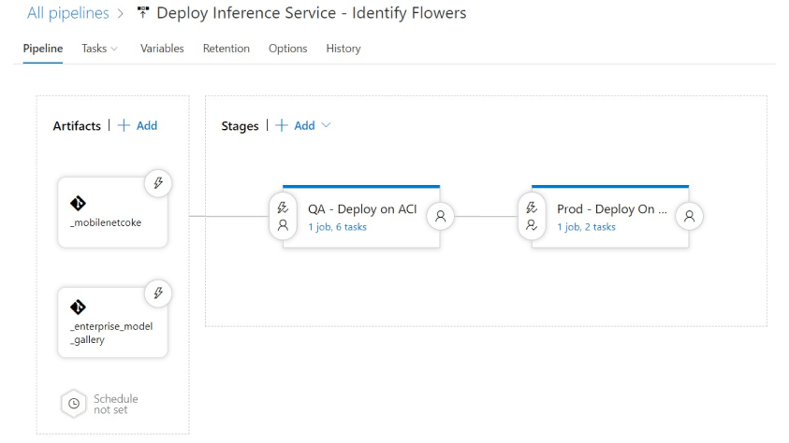
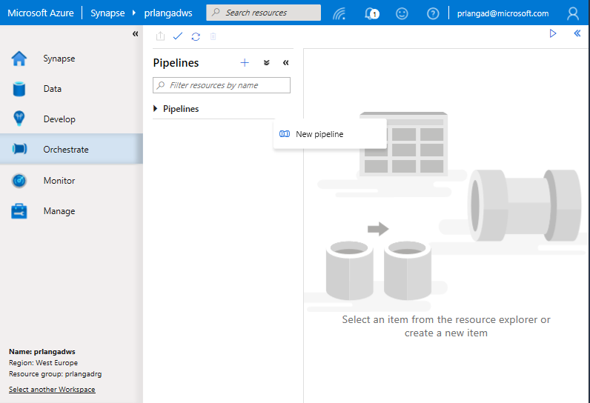

Built an ML powered app to reduce inventory shrinkage and simplify the checkout process
Automated training, deployment and monitoring of models
Full Lifecycle Management
Notes:
Azure Machine Learning also integrates with Azure DevOps. Anytime the model registry in AML gets updated, it kicks off a DevOps process (in this case a release pipeline).
AML also works with GitHub actions and Jenkins. These integrations allow organizations to extend their DevOps systems to become MLOPs systems with AML.

Slide 31
Azure Machine Learning
Customers
Azure Machine Learning
Customer promise
For all Skill levels
Industry leading MLOps
Responsible ML
Open and interoperable

Slide 32
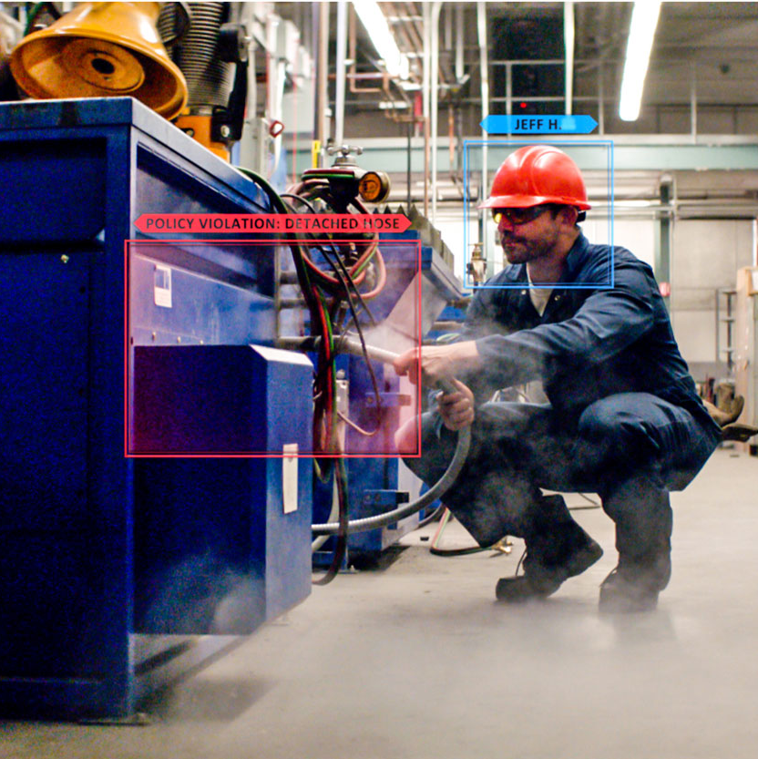
Understand
Interpretability
Fairness
Control
Audit trail
Datasheets
Azure Machine Learning
Protect
Differential privacy
Confidential machine learning
Responsible ML

Slide 33
Understanding models with Interpretability Built-in model explanations available at training and inferencing Glass box and black box explainers for your custom needs Data understanding, feature importance and local or global explanations for a data point or dataset Out-of-box visualizations for model predictions and explanations
Notes:
Databricks
Ability to execute (very good feedback)
OSS commitment

Slide 34
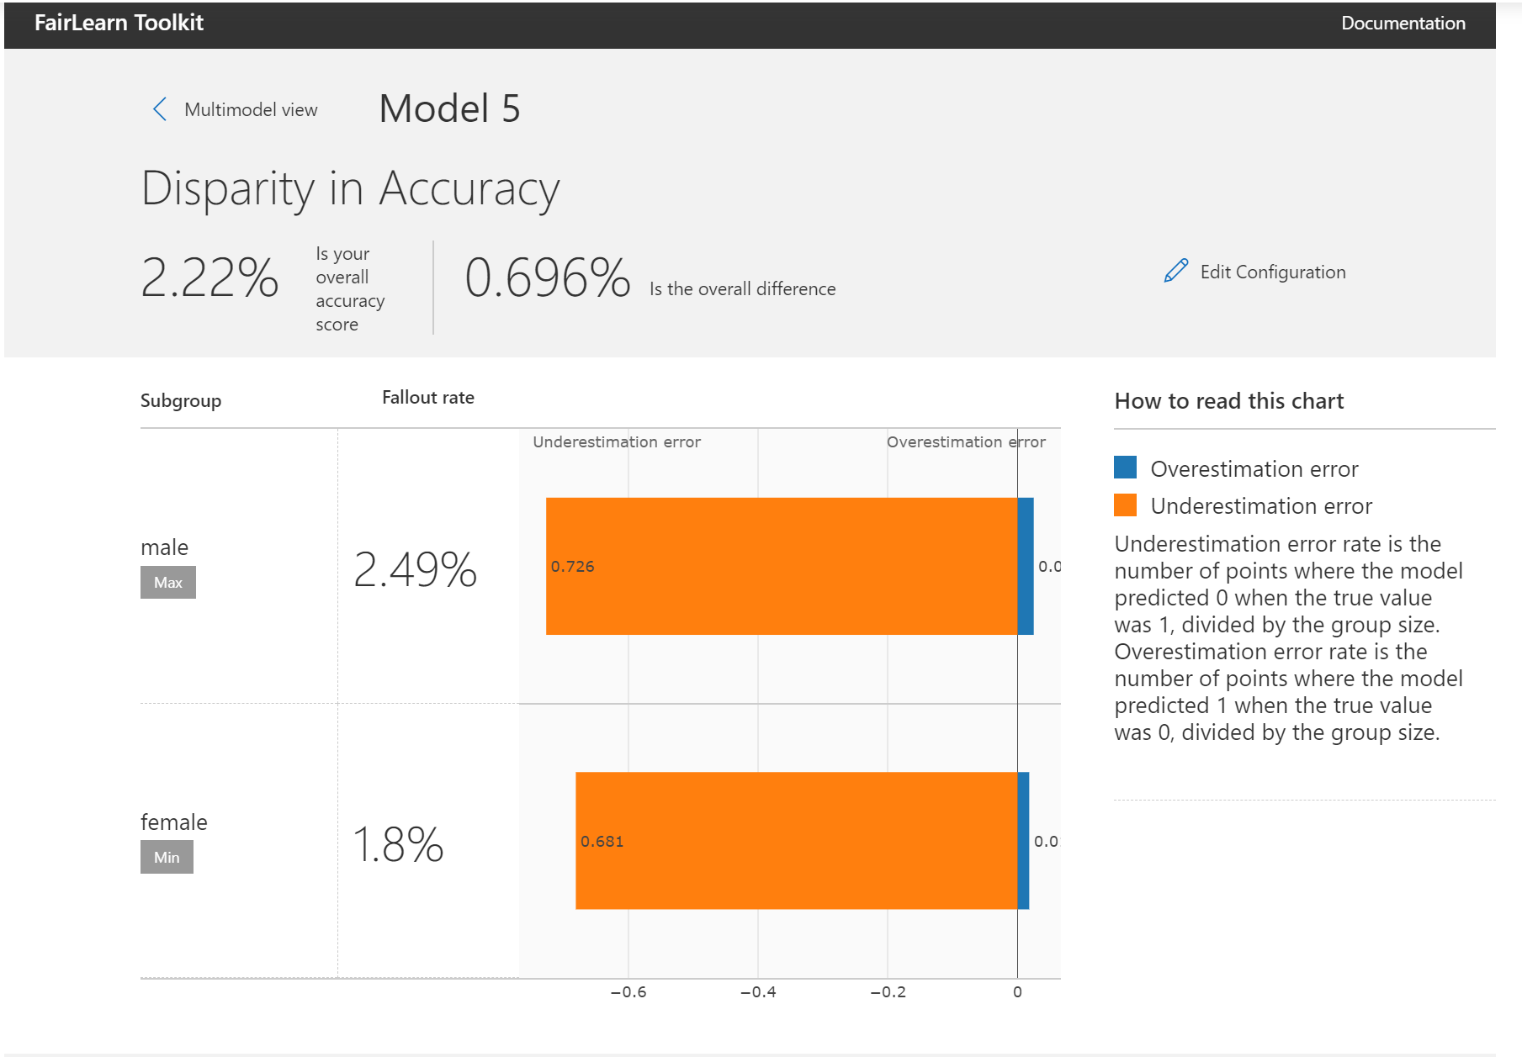
Mitigate unfairness with FairLearn Open source unfairness assessment and mitigation tools for individual and group Individual and group fairness metrics to check for bias in datasets and models Intuitive and configurable set of visualizations to compare before and after fairness performance of a model or make comparisons across models
Notes:
Databricks
Ability to execute (very good feedback)
OSS commitment

Slide 35


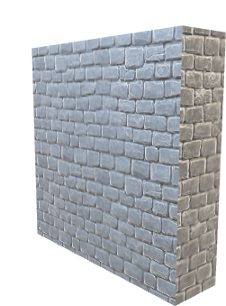
Apply Differential Privacy
Animate to show with and without WhiteNoise (above and below blue line)
Process query only if privacy budget allows
Submit a query
Receive differentially private data
Receive sensitive data
User
Private Dataset
Differential Privacy Toolkit
Introduce statistical noise Manage privacy budget

Slide 36
Manage Audit Trail & Datasheets
Model
Audit Trail
Datasheets
Track the end to end lineage and build audit trail
Documenting model metadata

Slide 37
Responsible ML Demo

Slide 38

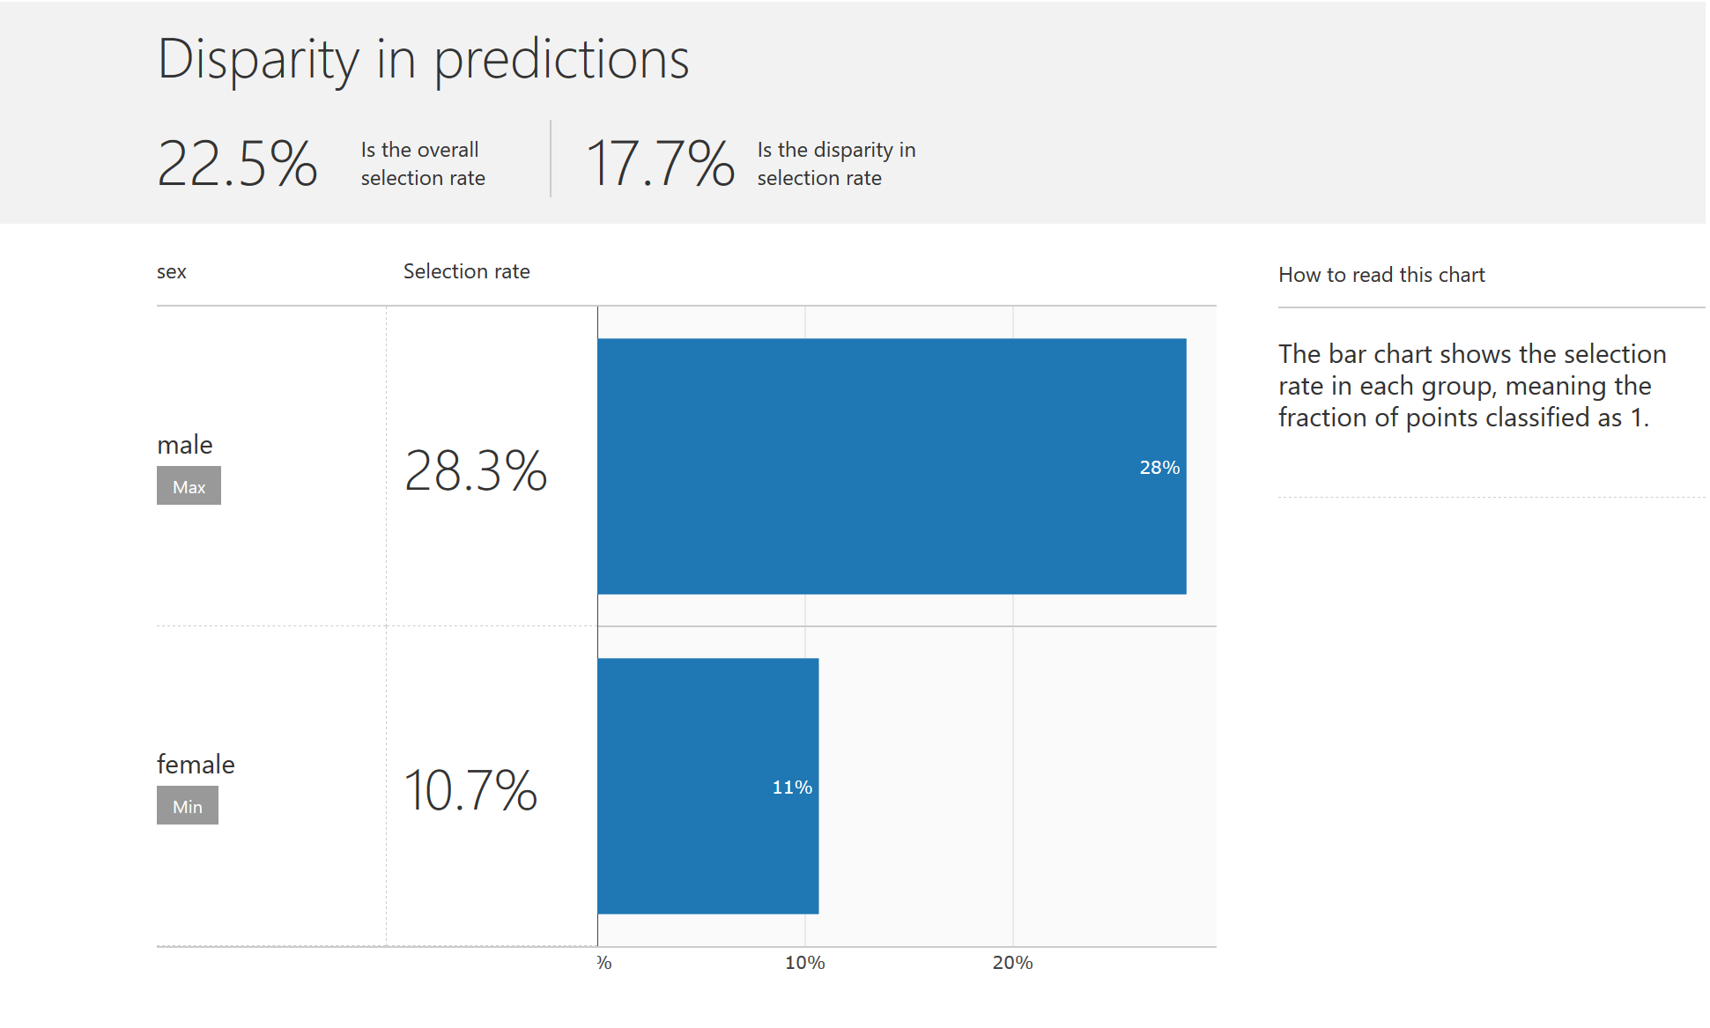
Augmented their analytics & AI platform with responsible ML capabilities to mitigate unfairness in models
Reduced disparity in loan decisions from 7% to 0.5%
Responsible ML
Understand | Protect | Control
Notes:
Now, building and deploying machine learning models is only useful if organization fully trust the predictions. To help with this we’ve recently launched a number of responsible machine learning capabilities in Azure Machine Learning. Built on top of OSS toolkits from MSR, these capabilities toolkits empower data scientists and developers build responsible ML solutions.
Using AML, customers can:
Understand model behavior in addition to assessing and mitigating unfairness.
Protect and maintain confidentiality of data and models using differential privacy techniques
Control the entire machine learning process by tracking lineage and maintaining audit trail of all ML assets.
Let’s take a look at E&Y which has augmented its AI platform with the Azure Machine Learning responsible ML capabilities to assess and mitigate unfairness in models. E&Y works with a lot of banks to optimize their loan process. When a bank grants and denies a loan, the reasons must be appropriate, fair, and defensible. But what if an algorithmic system denies a loan? How do you know it has done so for the right reasons? Exactly what factors do machine learning models take into account? How does an organization know whether its AI system is behaving unfairly?
EY used Azure Machine Learning to address these issues. When working with a client, they realized that their models had a disparity of 7 percent between men and women in the accuracy of approving or denying loans. By incorporating ALM’s fairness capabilities, E&Y was able to choose from the recommended models designed to mitigate bias. After mitigation, E&Y was able to reduce the disparity was less than 0.5 percent.
Link to E&Y Case Study: https://customers.microsoft.com/en-us/story/809460-ey-partner-professional-services-azure-machine-learning-fairlearn

Slide 39
Azure Machine Learning
Customers
Azure Machine Learning
Customer promise
For all Skill levels
Industry leading MLOps
Responsible ML
Open and interoperable

Slide 40
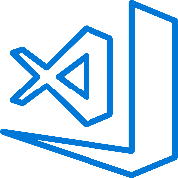
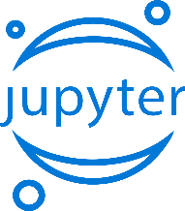


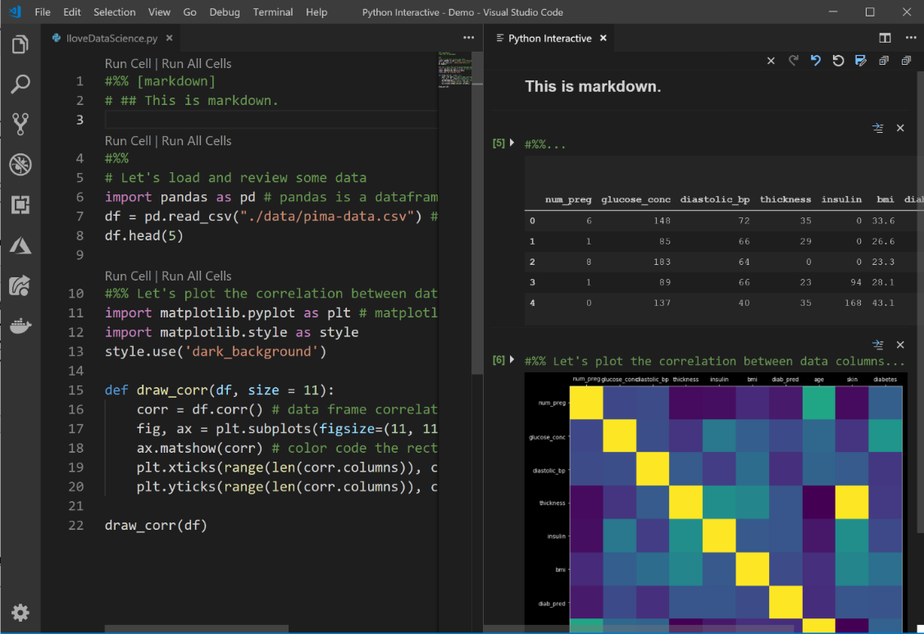
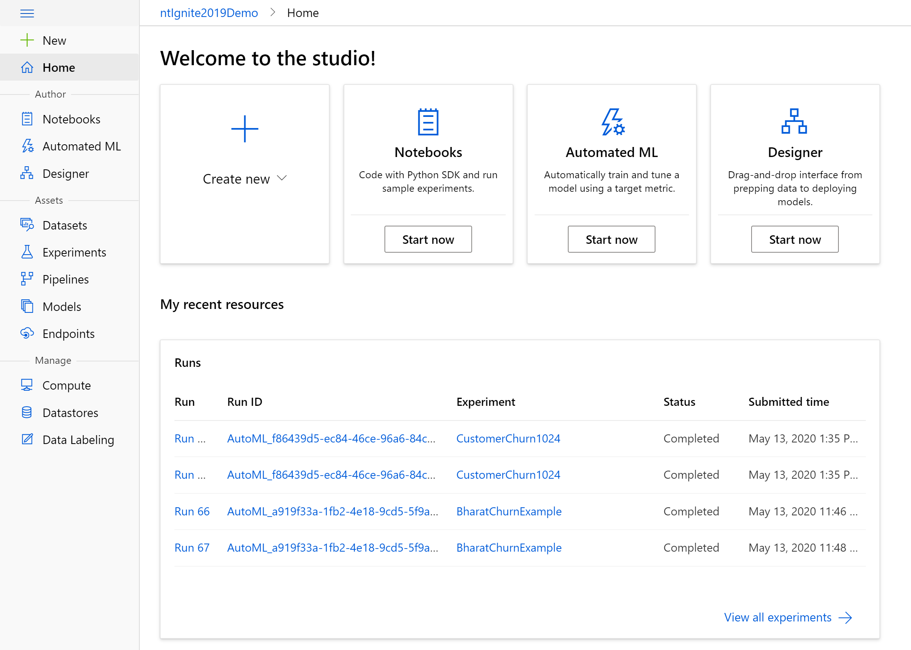
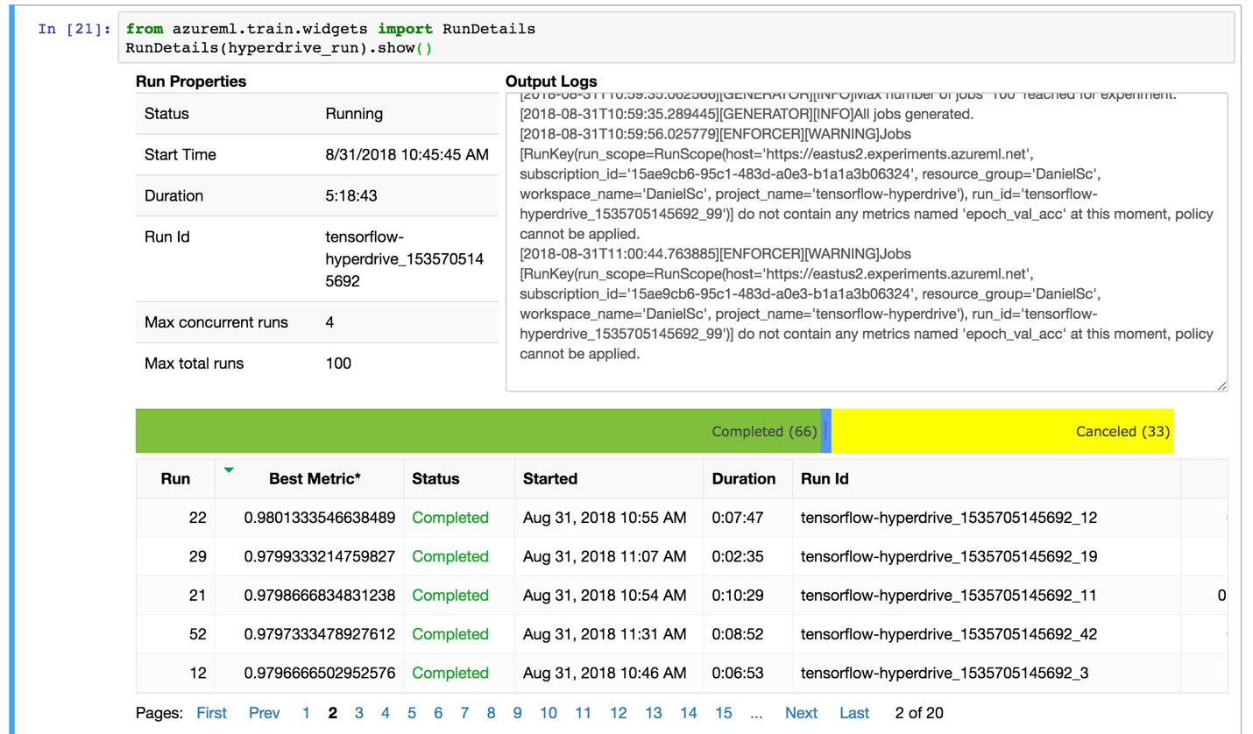

Familiar Data Science tools
Choose any python development environment
Jupyter
PyCharm
Zeppelin
Command line
Visual Studio Code
Azure Notebooks
And improve data science productivity
Interactive widgets for Jupyter Notebooks
Azure Machine Learning for Visual Studio Code extension
Notes:
Put a link to Azure Notebooks samples
https://aka.ms/aznotebooks-aml
Azure ML provides the flexibility for customers to bring their tool of choice.
Don’t need to change your habits, no uncomfortable unlearning/re-learning
We also provide widgets and extension for tools to make them more efficient to use for ML

Slide 41









Powerful frameworks
Build advanced deep learning solutions
Use your favorite deep learning frameworks
without getting locked into one framework
TensorFlow
PyTorch
Scikit-Learn
ONNX
Community project created by Facebook and Microsoft
Use the best tool for the job. Train in one framework and transfer to another for inference
MXNet
Chainer
Keras
Notes:
Our approach to ML frameworks is simple.
We give customers the flexibility to choose their deep learning framework, without getting locked one framework.
To help with this we’ve created a community project in partnership with Facebook that allows customers to train in one framework and use another one for inference

Slide 42
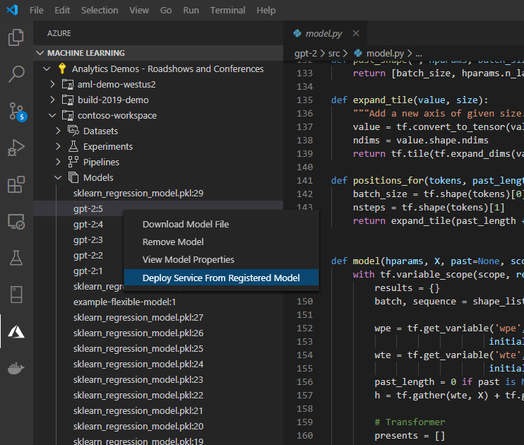

TALENTCLOUD
Built an ML powered app for sustainable farming
Used VS Code, PyTorch, Caffe, TensorFlow and ONNX Runtime
Open & Interoperable
Notes:
Now, let’s move to another customer. This time a ‘digital native’ – a type of customer which Microsoft typically does not engage. These customers are usually very OSS friendly. This is especially true in machine learning where OSS has become the de-facto standard. Rise of R, Python, TensorFlow, PyTorch is putting a lot of pressure on legacy players. Most new data scientists and developers are schooled in these languages vs. legacy tools.
Azure Machine Learning notebooks come pre-installed with multiple OSS tools and frameworks such as PyTorch, TensorFlow, and scikit-learn. Furthermore, data scientists and developers can choose the development tools that best meet your needs, including popular IDEs such as VS Code, Jupyter notebooks, and CLIs.
Let’s look at TALENTCLOUD that used not one but multiple OSS tools.
TalentCloud’s Agro-Brain app helps farmers get visibility into crop status and recommendations based on the latest agricultural science. That means less pollution and use of pesticides, higher quality and safety, and wins for everyone, from producer to consumer to the environment.
TalentCloud uses Azure IoT to collect an array of data points—including soil conditions, air temperature, and humidity. Camera images of crops and mobile device data supplement quantitative data. Sensors connect directly to Azure IoT Hub, which feeds data into Azure Machine Learning, rapidly training the models created by TalentCloud data scientists. The team uses Visual Studio Code to build solutions and deploy them in the cloud. TalentCloud uses a combination of frameworks that work best for each scenario, including PyTorch, TensorFlow, and Caffe. ONNX and ONXN RunTime are used to standardize the machine learning models and deploy them at the edge.
Link to TALENTCLOUD story - https://customers.microsoft.com/en-us/story/811327-talentcloud-partner-professional-services-azure

Slide 43


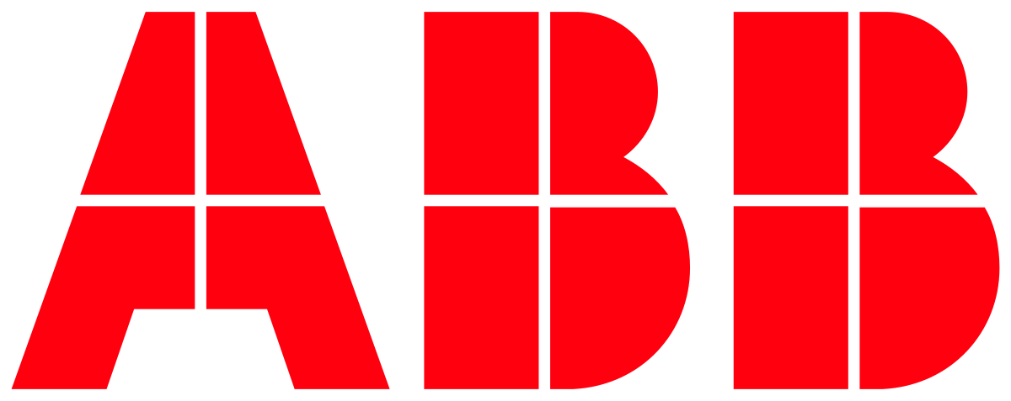

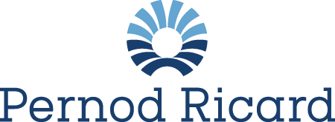





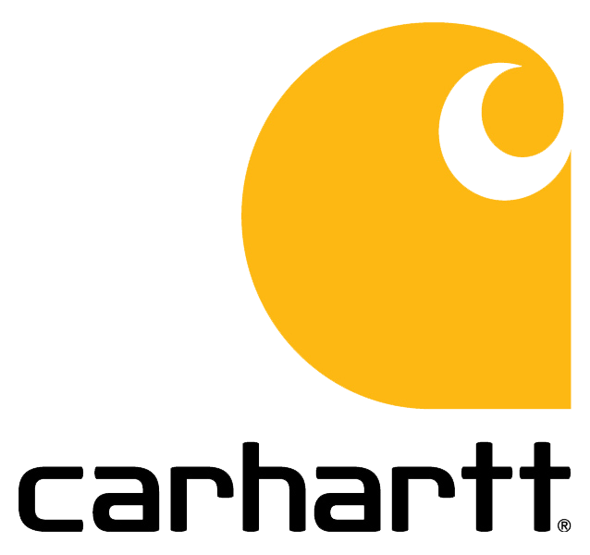
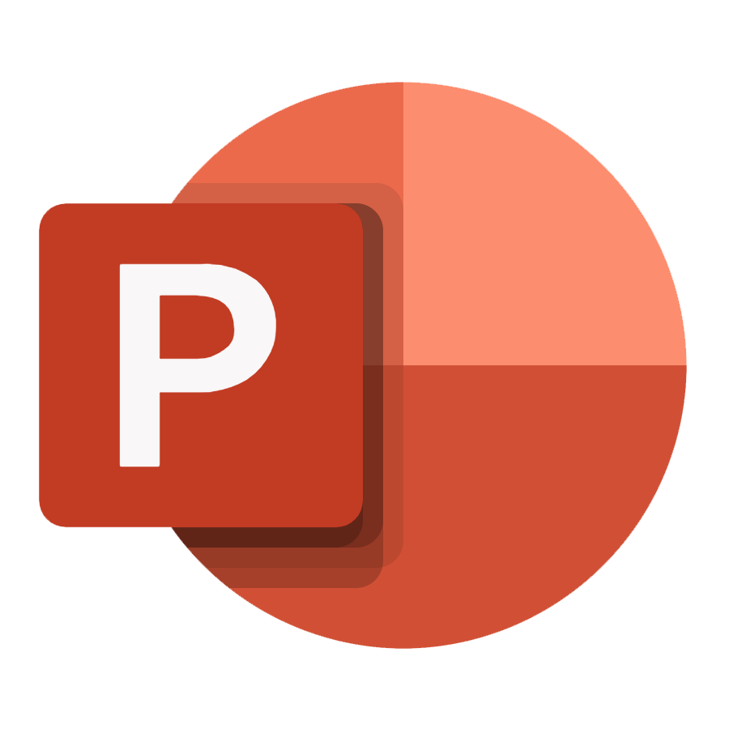


Common Usage Patterns
Augmenting analytics with ML
ML powered Apps
Walgreens Boots Alliance
TALENTCLOUD
Campaign Optimization
Loan Processing
Store Monitoring
Sustainable Farming
Inventory Forecasting
Demand Forecasting
Autonomous Driving
Fish Farm Monitoring
Sales Forecasting
Sales Forecasting
Predictive Maintenance
Art Explorer
Supply Chain Forecasting
Supply Chain Forecasting
PowerPoint Designer
Suggested Replies
Notes:
From these examples and many more we’ve identified two main ML customer patterns.
A number of customers are adding predictive capabilities to their analytics platforms using Azure Machine Learning. These are typically forecasting types of scenarios. Integration with ML helps enhance the value of our analytics offerings.
Another very common trend we see is customers building ML powered apps. These are ML led scenarios. In these case we win or loose based on our ability to compete with AML. These scenarios also pull in quite a lot of related Azure services which are needed to build the app.

Slide 44
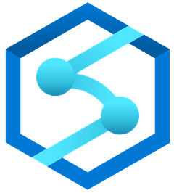




Azure Machine Learning
Summary
Seamless studio experience for all skill levels
Notebooks
Automated ML UX
Designer
Structured data
Forecasting types of ML scenarios
Apps
Models: AKS
Batch predictions: SQL DB
Comprehensive MLOPs capabilities
Reproducibility
Automation
Deployment
Re-training
Powerful compute
Unstructured data
All other ML scenarios; NLP, Vision, IoT, etc.
Analytics
Azure Arc
CPU, GPU, FPGAs
IoT Edge

Slide 45
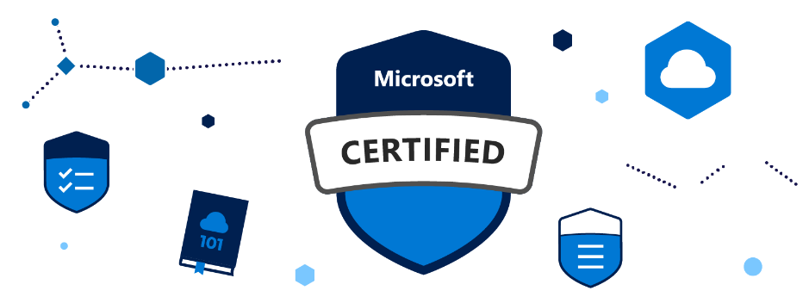
Q&A
More on-demand content
Free Trial
https://aka.ms/aishow
https://aka.ms/azure-ai-free
Learning & certifications
Resources
https://microsoft.com/learn
https://aka.ms/ai-certs
Look through the resources section of this session for additional resources

Slide 46
Questions

Slide 47
Thank You!

